Slide 1
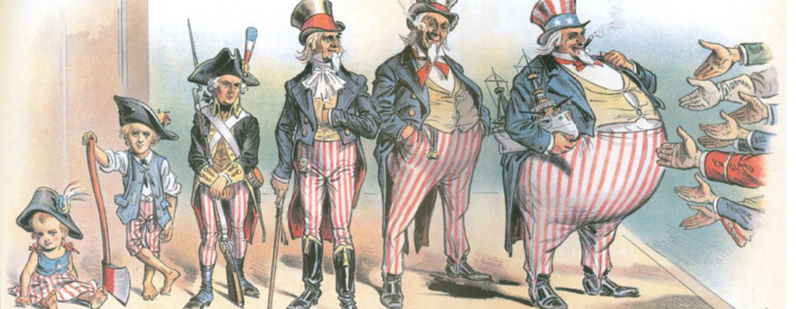
Chapter 2: The Expansion of U.S. Power, 1787 - 1939

Slide 2
Learning objectives:
After today's class you should be able to:
Discuss the U.S.’s pattern of economic and territorial expansion in the nineteenth century.
Explain the following concepts and their relationship to U.S. foreign policy:
Manifest Destiny on the Western Frontier
Opening the Door to Asia
A Big Stick in Latin America
Discuss U.S. involvement in the two World Wars and how it affected the global power position of the country.

Slide 3
Economic and Territorial Expansion
Under the Articles of Confederation (1781), a weak central government made the United States vulnerable to intimidation from great powers.
They were replaced by the Constitution in 1787, giving federal government more control and dividing foreign policy powers between the president and Congress (Madison’s influence).
However, the separation of powers and institutional design did not encourage diplomacy.
Little funding and personnel for state department
Notes:
Learning Objective: 2.1

Slide 4
Economic and Territorial Expansion
Debates on how to pursue becoming a powerful nation
Alexander Hamilton: Strong industrial setting and large central government
Thomas Jefferson: Small farming communities and strong state power
Primary foreign policy goal = economic relations (trade)
Favored unilateralism: No entangling alliances.
“Neutrality” during the Napoleonic Wars (1793-1814)
Limited institutions for foreign policy making and implementation.
U.S. policy makers favored isolation in theory; in practice, continued to pursue expansion.
United States moved westward, away from European involvement.
Expansion of trade relations.
Notes:
Debates over what future of American politics and relations with the world should look like
Despite a general sense of disengagement, the US was actually very engaged in foreign relations, especially pro-active in the field of foreign economic relations and trade policy.
Hired lots of consular officers to negotiate trade deals.

Slide 5
Manifest Destiny on the Western Frontier
Global balance of power: Multilateral (anchored by European powers), with U.S. as emerging “offshore power”
U.S. moved to fill geographic vacuum, became regional power by default and by declaration (Monroe Doctrine 1823)
Question: Why did Monroe Doctrine matter?
Territory purchased and forcefully gained to increase U.S. economic and military power (emphasizing paradoxes)
Jefferson’s executive authority in the Louisiana Purchase, acquisition of Florida, Texas
Conflict with Native Americans over expansion and assimilation
U.S. influence in Latin America (regional hegemony)
Notes:
Also see a lot of activism in the negotiated or forceful annexation of territory.
Monroe doctrine also shut out European powers and declared western hemisphere as the U.S.’s sphere of influence

Slide 6
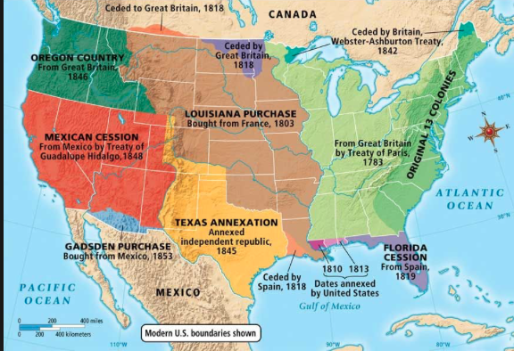
Notes:
Here we can see how the US was very active
What does this map not really tell us?

Slide 7
“Opening the Door to Asia”
Gunboat diplomacy: President Fillmore sent naval vessels to Tokyo (1853) after failed negotiations to establish commercial relations
Results in 1854 treaty of friendship between U.S. and Japan
Annexation: Hawaiian Islands (1893) and Alaska (1867)
Appealing because of geographically strategic value
Intervention: U.S. forces ousted Spanish from Cuba and the Philippines
McKinley focuses on Philippines, breaks general rule against colonization
Did not attempt to colonize Cuba
Open-door policy: Preventive measures in China
Policy makers did not want European powers to carve up China to serve their own trading interests
Notes:
See the same kind of activism also outside the American continent
Goal was to tap into the enormous markets that existed in Asia.

Slide 8
A Big Stick in Latin America
Theodore Roosevelt: “Speak softly, but carry a big stick.”
1905: Negotiated the end of Russo–Japanese War (and won a Nobel Peace Prize)
1907: Deployed naval armada around the globe to show U.S.'s strength
Believed wars were both inevitable and noble
Ordered military interventions in Dominican Republic (1904), Honduras (1905), Cuba (1906), and Panama (1908)
Interested in more history? Dan Carlin’s “The American Peril”
Notes:
Learning Objective: 2.1

Slide 9
Justifying Expansion
Political rationale: Monroe Doctrine detached U.S. from Europe, but strengthened regional hegemony, declaring regional sphere of influence
Moralistic rationale: Manifest Destiny—cultural and religious justification for westward territorial expansion
Economic rationale: Opening new markets, helping commercial sectors with trading partners
Implementing tariffs and low-interest loans to promote U.S. trade
Growing the agricultural sector
Notes:
Learning Objective: 2.1

Slide 10
The First World War
1914: European conflicts over territory and nationality
President Wilson attempts to keep U.S. “neutral in fact as well as name”
1915: U.S. national interests threatened by German navy sinking merchant vessels, sinking of the Lusitania
1917: Security concerns lead Congress to declare war against Germany
U.S. contributed to war efforts on two fronts
Provided munitions, weapons, and medical supplies to allies
Deployed reinforcement troops to Western front to relieve British/French troops and stage counteroffensive
1918: Germany surrenders due to U.S. reinforcement measures
Notes:
Learning Objective: 2.2

Slide 11
Failed Efforts to Keep the Peace
Mixed incentives led to U.S. involvement in European affairs
Policy makers uncomfortable with security policy based on geopolitics
The distribution of global power should not be tilted too heavily toward one European country (e.g., Germany)
President Wilson’s moralistic sense of duty
All citizens should be free to determine their own destinies—“Making the world safe for democracy”
Notes:
Learning Objective: 2.2

Slide 12
Failed Efforts to Keep the Peace
[Incentives to maintain U.S. involvement in European affairs (con’t.)]
World War I to be “war to end all wars”
So destructive as to end all future global conflicts
Collective security: Leaders renounce war as instrument of statecraft; countries defend one another against aggressors
Wilson’s “Fourteen Points” outlined steps to world peace, including. . .
Freedom of markets, seas, governance
Also provided framework for global collective security organization—became the League of Nations
Notes:
Learning Objective: 2.2

Slide 13
Failed Efforts to Keep the Peace
Outcomes of League of Nations:
Congress refuses to ratify treaty, U.S. does not join the organization
Resented Wilson’s actions during the negotiations of the Treaty of Versailles
.
League fails to intervene when Japan invades Manchuria (China) in 1931 and when Italy invades Ethiopia (1935)
Collective-action and free-rider problems plague organization
Creates a false sense of security
Notes:
Learning Objective: 2.2

Slide 14
Failed Efforts to Keep the Peace
U.S. absence hurt League of Nations, but did not deter U.S. from looking for other preventative measures to limit future world wars
Anti-war efforts: U.S. attempts to stop military conflicts and prevent new wars
Calls for disarmament, Kellogg-Briand Pact
Collective security efforts (through League of Nations) fail to curtail power politics by Italy, Germany, and Japan
Notes:
Learning Objective: 2.2

